Slide 1


Slide 2
Why Classes?
Object
Class Definition
Object
Object

Slide 3
Why Classes?
Employee Object
Employee
Employee Object
Employee Object

Slide 4
Why Classes?
Employee Object “Scott”
Employee
getName doWork
Employee Object “Alex”
Employee Object “Chris”

Slide 5

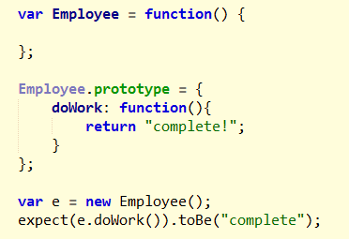

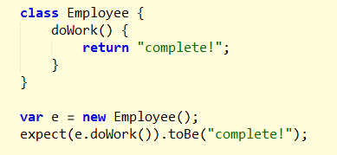
Class versus Prototype

Slide 6

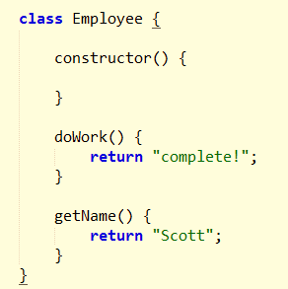
constructor

Slide 7

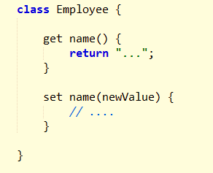
Getters and Setters

Slide 8

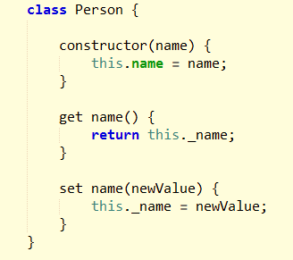


Inheritance

Slide 9

Employee is a Person
Circle is a Shape
Car is a Vehicle
Car is an Engine

Slide 10
Person
Employee (is a Person)
Manager
(is an Employee)
Executive (is a Manager)

Slide 11


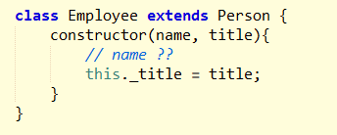
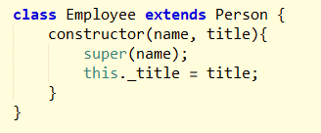
super

Slide 12

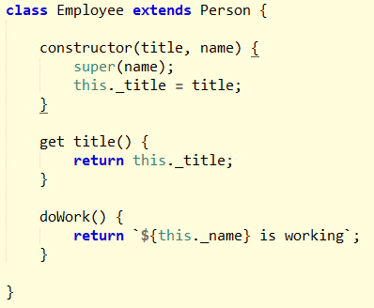
Conclusion

